Slide 1
Capstone Presentation By: Trevor HOfmann

Slide 2

Purpose
The purpose of this presentation is to describe the premise and purpose of the synthesis prototype project demo with respect to how the PRODUCED ARTIFACT is a reflection of the synthesis and how a fully realized version of the artifact would be a good reflection of the synthesis of the dimensions accounted for in the artifact Software Systems (SS), Business Analytics (BA), Data Management (DM), Cybersecurity and Networking (CN)

Slide 3
Big Picture (Assessment App)
Create and track alignment assessment
01
Create recommendations that will become project
02
Consolidate data from multiple sources
03

Slide 4
Four Curriculum Areas
Cybersecurity and Networking (CN)
Software Systems (SS)
Business Analytics (BA)
Data Management (DM)

Slide 5
Customer Summary

Slide 6
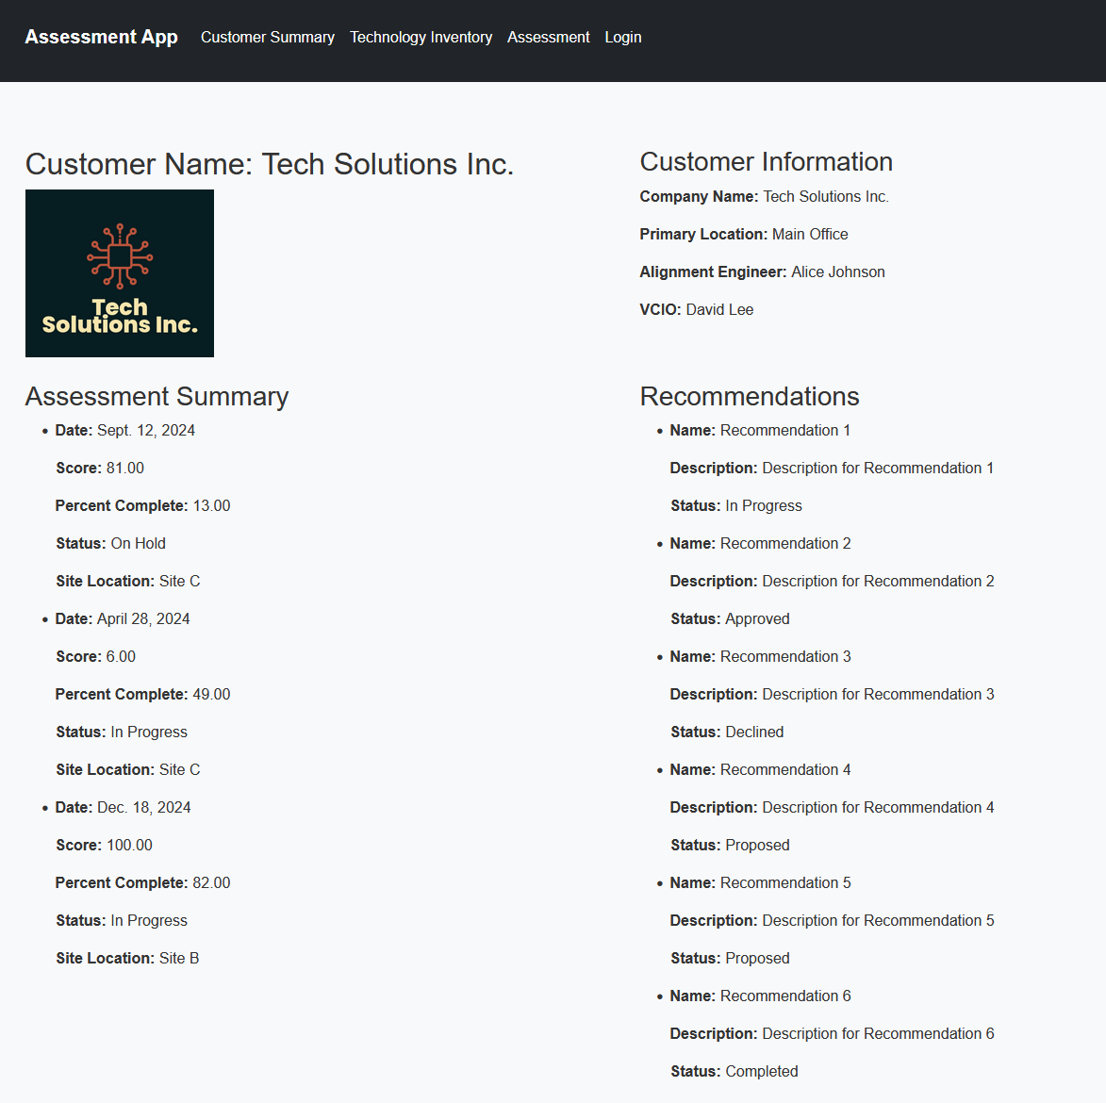

Slide 7
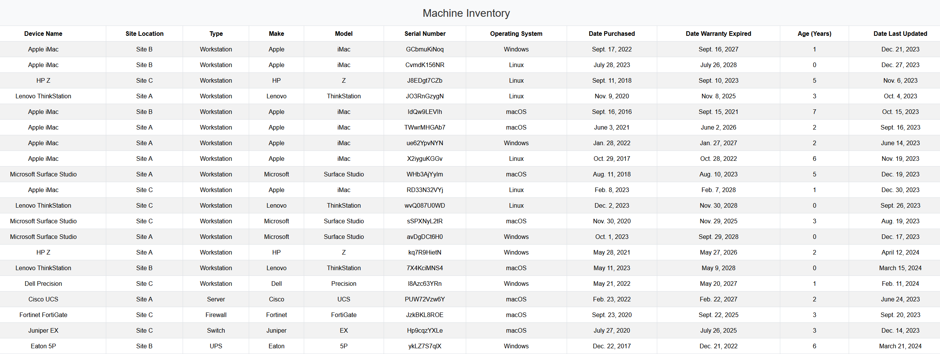

Slide 8
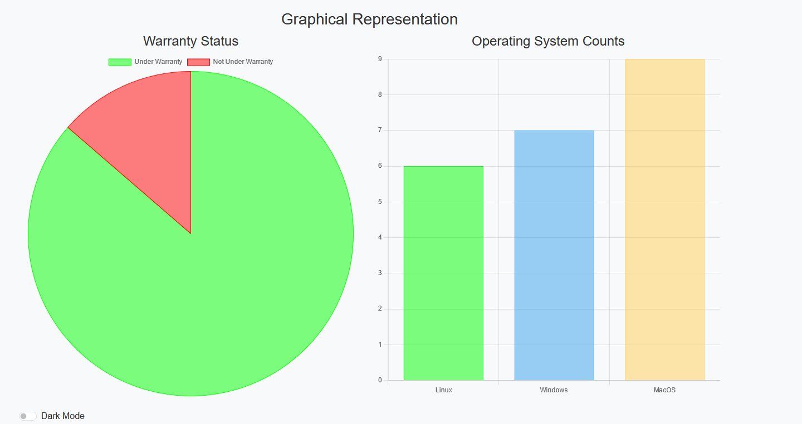
Effective delivery techniques
This is a powerful tool in public speaking. It involves varying pitch, tone, and volume to convey emotion, emphasize points, and maintain interest.
Pitch variation
Tone inflection
Volume control
Effective body language enhances your message, making it more impactful and memorable.
Meaningful eye contact
Purposeful gestures
Maintain good posture
Control your expressions

Slide 9
Technology Inventory

Slide 10
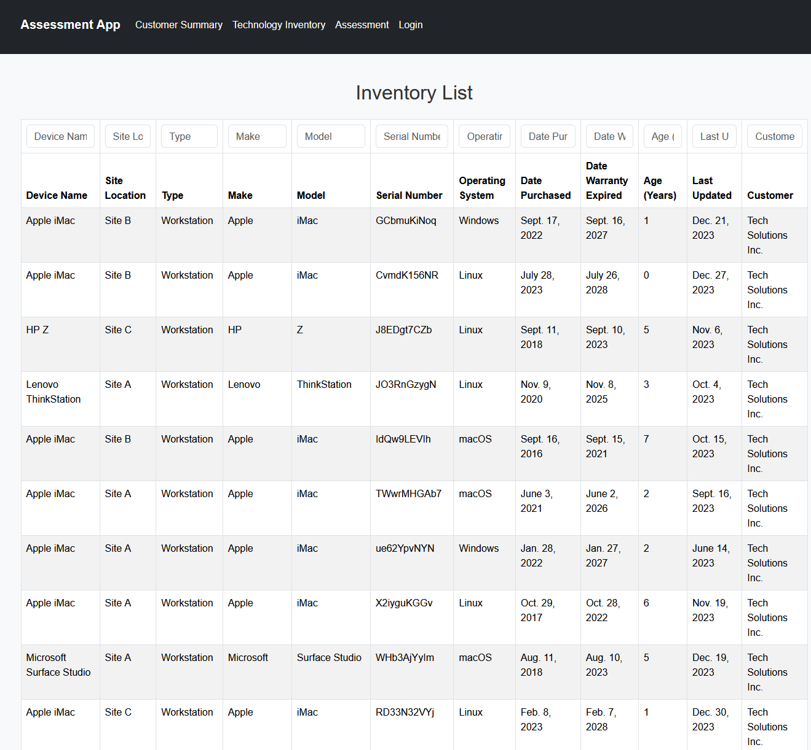

Slide 11
Assessment

Slide 12
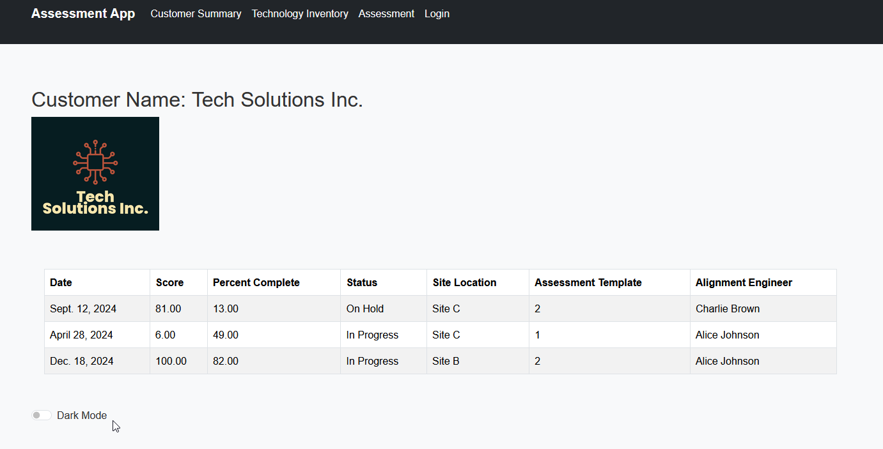

Slide 13
Where can this go

Slide 14

Thank you
By: Trevor Hofmann

